Slide 1
FLIGHT DELAY ANALYSIS
Rangaswamyreddy Kappeta
Ranadeep Reddy Gurram

Slide 2
Problem Statement
"Airline delays have a significant impact on customer satisfaction and operational efficiency. The objective of this project is to analyze airline delay data and identify the key factors contributing to delays.Performing various visualizations on analyzing various trends on flights .
By understanding the causes of delays, airlines can take proactive measures to improve their on-time performance and minimize customer inconvenience.
The project aims to provide insights into the patterns and trends of airline delays, identify the major delay factors, and explore potential strategies for mitigating delays."
This issue statement establishes the project's framework and lists the precise aims and objectives that data analysis will be used to accomplish.

Slide 3
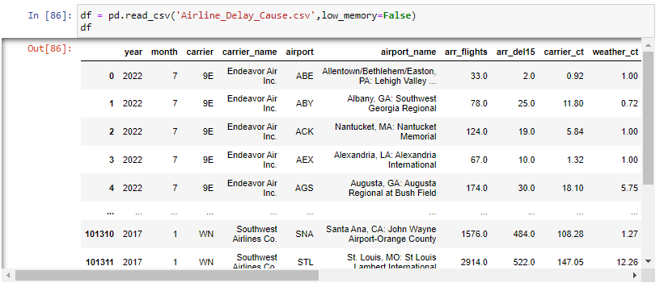
Exploratory Data Analysis(EDA)

Slide 4
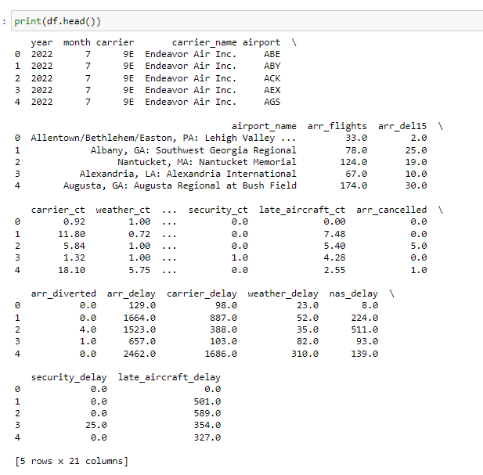
Exploratory Data Analysis(EDA)

Slide 5
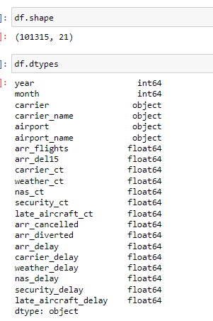
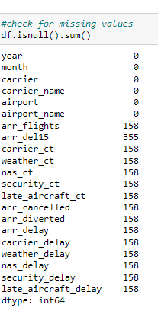
Exploratory Data Analysis(EDA)

Slide 6
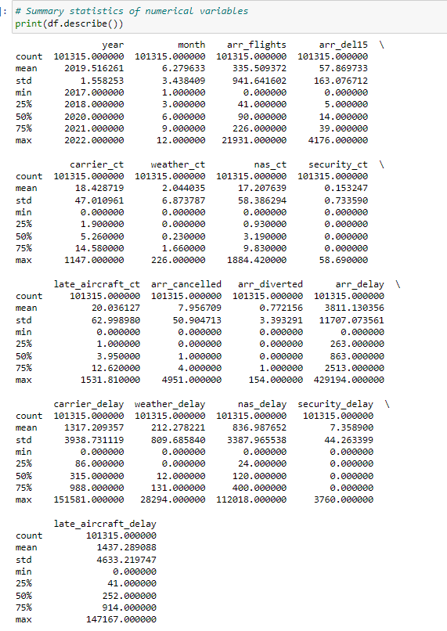
Exploratory Data Analysis(EDA)

Slide 7
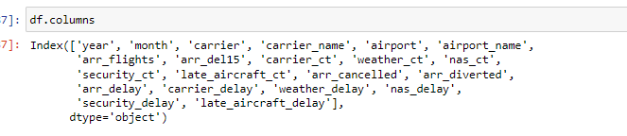
Exploratory Data Analysis(EDA)

Slide 8
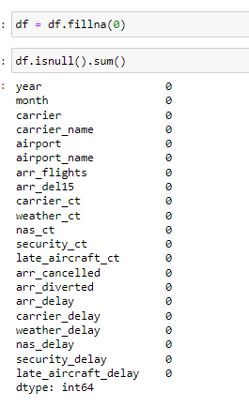
Exploratory Data Analysis(EDA)

Slide 9
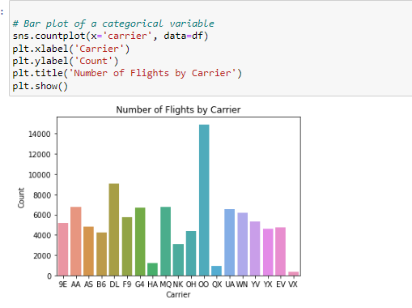
Visualization

Slide 10
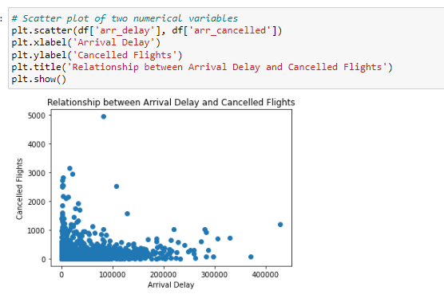
Visualization

Slide 11
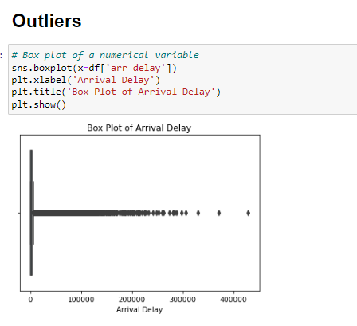
Visualization

Slide 12
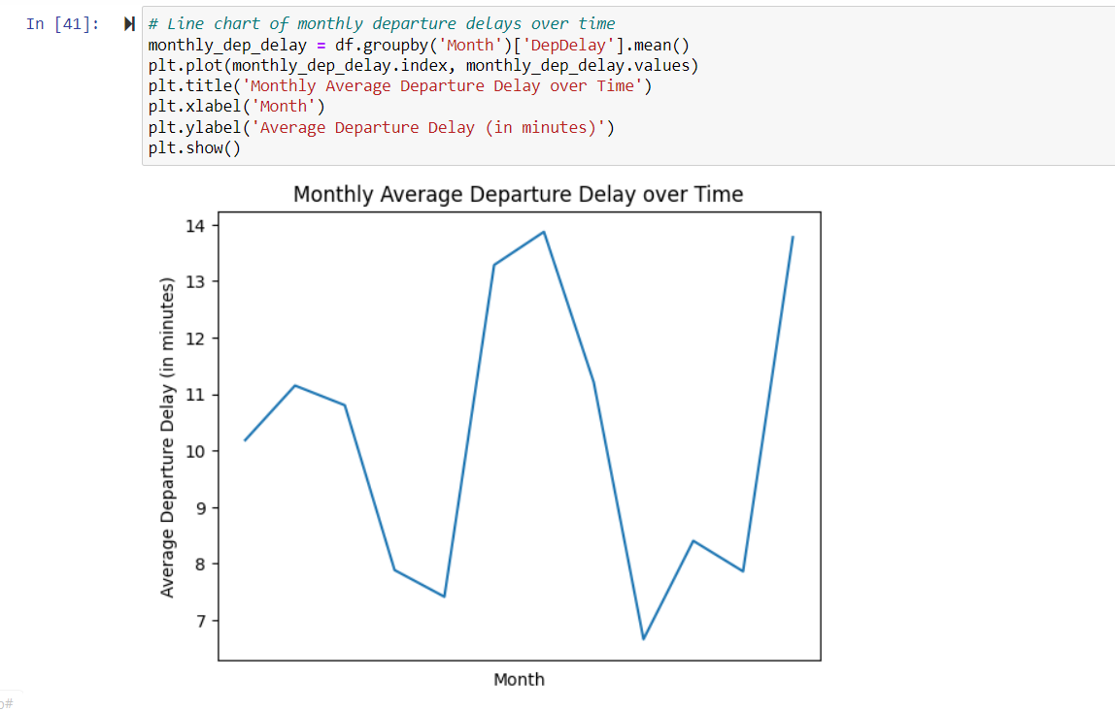
Visualization

Slide 13


